Slide 1
Discover Social Media TestDrive!
Notes:
Discover Social Media TestDrive! A fun online youth development program to teach digital citizenship

Slide 2
Yoon Hyung Choi
Postdoctoral Research Associate Social Media Lab, Cornell University
Amanda Purington
Director of Evaluation and Research ACT for Youth
Ellen Zou
Postdoctoral Research Associate Social Media Lab, Cornell University

Slide 3
1
4
Current Trends of Social Media Use
TestDrive Implementation
2
5
Getting Involved: Research
History and Research Behind TestDrive
3
6
Social Media TestDrive Walkthrough
Q&A

Slide 4
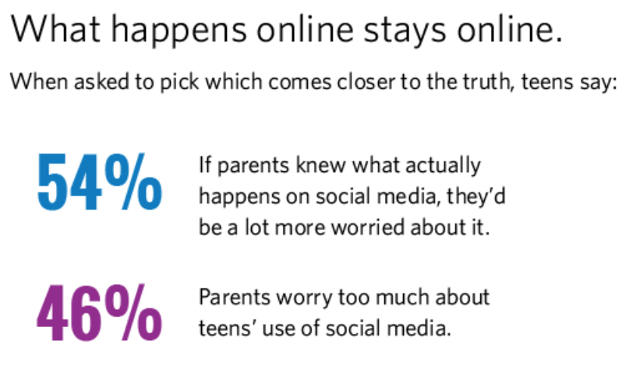
Teens and Social Media
Source: Social Media, Social Life: Teens Reveal Their Experiences (2018)
Notes:
About an even distribution between the options

Slide 5
Risks and Opportunities of Social Media
Source: Tweens, Teens, Tech, and Mental Health: Coming of Age in an Increasingly Digital, Uncertain, and Unequal World, Common Sense Media (2020)
Notes:
Teens’ social media use comes with opportunities and risks...

Slide 6
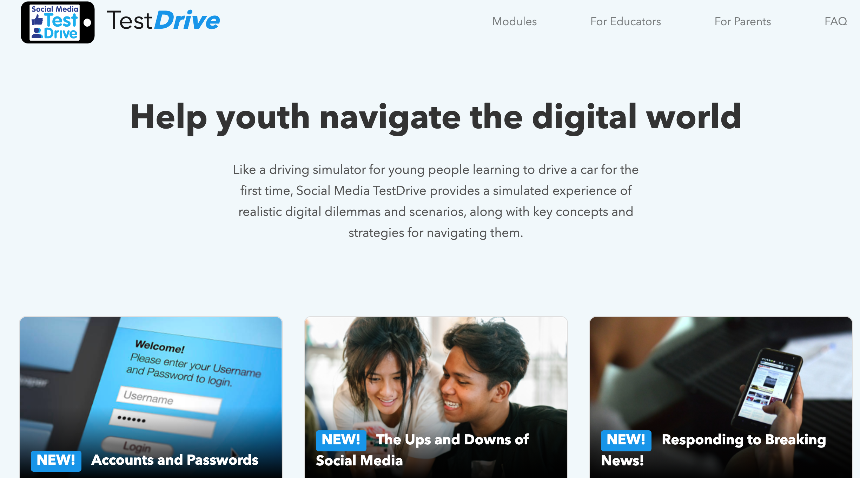
`
Social Media TestDrive
An educational tool that allows students to learn key digital citizenship topics by interacting with a social media simulation.

Slide 7
What is Social Media TestDrive?
Practice in a social media simulation
12 modules focused on specific digital citizenship topics
20 - 25 minutes to complete
Work individually
Part of a class activity
Notes:
TestDrive is a social media simulation that allows students to learn and to practice being digital citizens without having to create a real social media account!
The tool consists of 12 modules. Each module focuses on a specific digital citizenship topic and a set of related concepts.
The modules take 20 - 25 minutes to complete. Students can work on them on their own and at their own pace or as part of a synchronous class activity.

Slide 8
How Was TestDrive Developed?
From conversations with youth development educators
Adaptation of a social media simulation research platform
Experimentation & learning in a safe, realistic environment
Notes:
No good way for young people to practice social media skills without signing up for social media sites

Slide 9
What Makes TestDrive Unique?
Co-developed by Common Sense Education and the Cornell Social Media Lab
Uses experiential learning to foster an understanding of digital citizenship
Allows students to engage with digital dilemmas in a safe and private environment
Notes:
Experiential learning - Simulation provides a safe yet realistic social media environment for authentic experiences
Free to explore realistic social media simulation

Slide 10
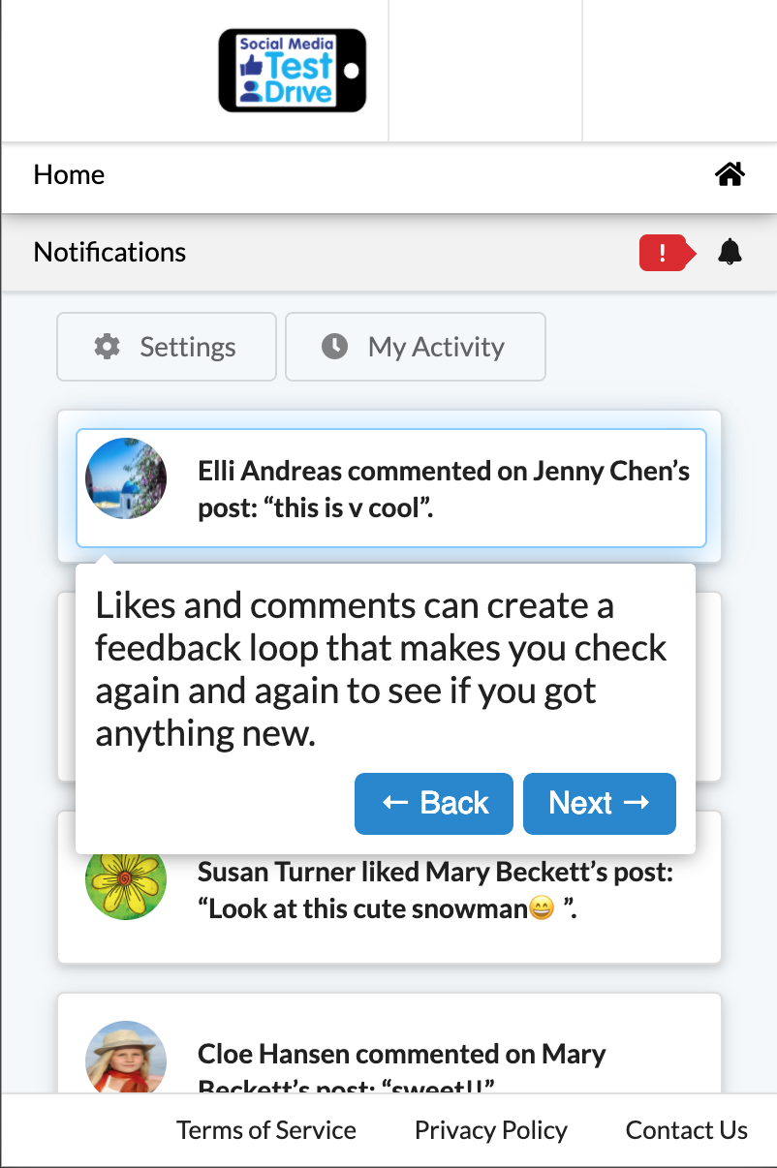
What Makes TestDrive Engaging and Safe?
Instagram-like timeline which includes:
‘Bot’ (fake) users
Scripted interactions and content
Learners can post, comment, like, etc.
Not connected to the wider internet (no information is saved)
Notes:
Cannot talk to anyone else, cannot upload their own pictures, no information is saved

Slide 11
TestDrive: Educational Goals
Solidify students’ understanding of key digital citizenship terms and concepts
Introduce students to a common social media interface and features
Allow students to practice prosocial behaviors in an interactive setting
Notes:
Yoon final slide
and the features that will help them be safe and responsible online (e.g. privacy settings, reporting function, etc.
(e.g. reporting hateful comments, identifying fake news, reflecting on their emotions, etc.)

Slide 12
TestDrive Modules at a Glance
1
Tutorial: Objectives, terms, definitions
2
Guided Activity: Model appropriate behaviors and actions
3
Free-Play: Practice without aids
4
Reflection: Reflect on engagement with the timeline
Notes:
Ellen starts
Tutorial: Students are introduced to the objectives of the module as well a the relevant digital citizenship terms and definitions.
Guided activity: Students are introduced to the TestDrive timeline. Visual aids scaffold students understanding of appropriate behaviors and actions.
Free-play: Students practice prosocial behaviors in a setting with no aids. They are free to navigate through the timeline however they want.
Reflection: Students are asked to reflect on their engagement with the timeline in the free-play section and whether they applied the skills they learned throughout the module.

Slide 13
The Ups and Downs of Social Media
Access through: https://socialmediatestdrive.org
Notes:
Ellen starts screen sharing
Demo - Ellen
Recommend: music option

Slide 14
Suggested Implementation
In-class activity led by an educator
Before module: pre-teaching of concepts (optional)
Students work through a module individually or in pairs
After module: in-class group discussion of reflection questions
Social Media TestDrive modules can be completed along with Common Sense Education lessons.
Notes:
Mandy

Slide 15
Implementing in Youth Programs
Educators facilitate in-person
Young people do activity on their own and talk about it online
Parents/caregivers and youth complete modules together at home
Notes:
Mandy

Slide 16
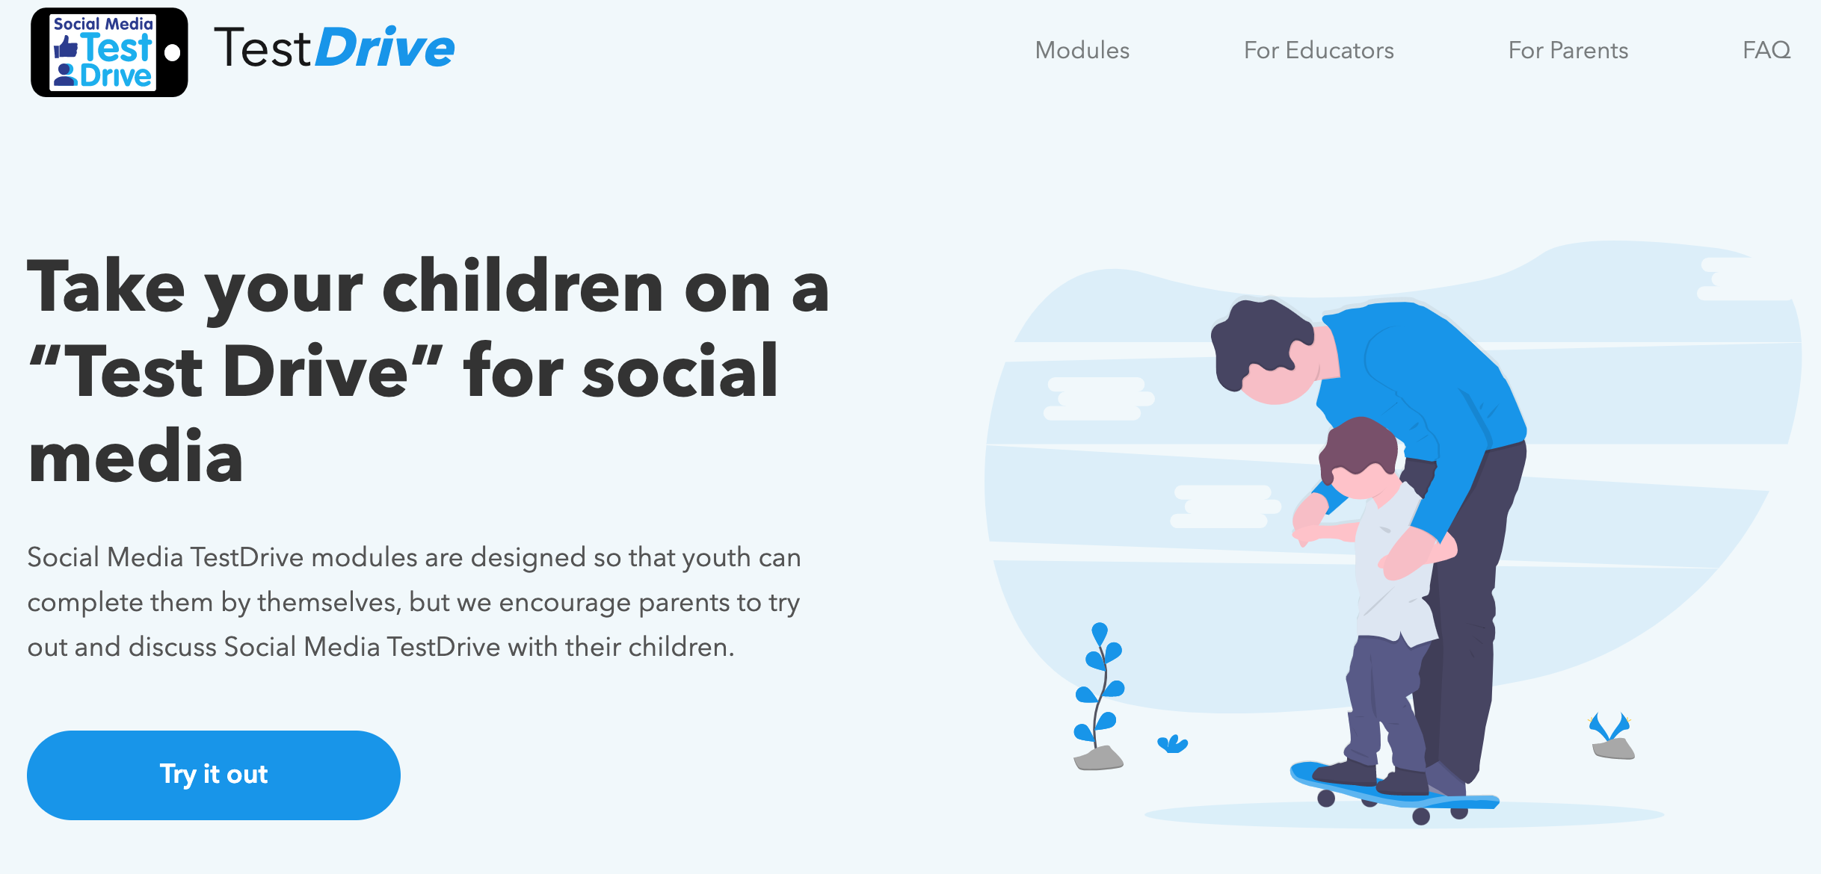
`
Family Engagement Tool
A good resource to engage parents and to encourage a whole-community implementation of Digital Citizenship.

Slide 17
Getting Involved: Research
Building the evidence for TestDrive’s effectiveness
3 upcoming studies:
30-45 minute survey (Jan 2021)
Complete 4 modules & surveys across 4 weeks (Feb 2021)
Complete 4 modules, surveys, & follow up across 5-6 weeks (Apr/May 2021)
Please contact Amanda Purington ald17@cornell.edu
Notes:
Mandy
Follow up = extended free play -- actually looking for behaviors in a social media simulation
Incentives will be provided

Slide 18
Q&A

Slide 19
Links and Contact Info
Website: https://socialmediatestdrive.org/
Contact us: socialmediatestdrive@gmail.com
For research participation: ald17@cornell.edu
Thank you!!

